Slide 1
HEALTHCA

Slide 2
BACKGROUND
4th revolutionary technology
Project background
Course background

Slide 3
INTRODUCTION

Slide 4
Our idea is to build an easy and helpful health care center. In our country, most of the people led their life with serious decease but detect after a long time. Lots of people in our country usually do not care about their health, they don’t even have the eager to know about their decease and also, they do not take medicine properly or without concerning a doctor.

Slide 5
For this reason, people have to face serious problems in the future. To solve this problem, we developed an app called Healthca. This app has all types decease information in his data base, which can help one individual by matching their symptoms with the help of his Ai system. This app also provides some other features like Near-by doctor finding, current health news, condition library.

Slide 6
PROBLEM DEFINITION
1. The tendency to underestimated on any disease
2. Lives below the poverty line. Lack of adequate amount of money to detect disease or take care of their health.
3. Carelessness in taking medicine.
4. Tendency not to showing the registered doctor to save money.
5. Lack of specialist’s doctor in many hospitals.
6. Lack of caution about the disease.

Slide 7
PROPOSED SOLUTION
1. AI Assistant: This will allow the user to accurately diagnose the disease based on the data feedback provided.
2. Finding Doctors: Ai and GPS will find the best doctor based on the disease.
3. Current Health News: It Will always provide the best true news and awareness about health.
4. Condition Library: Anyone can find all the information about any Diseases and see the most read articles by users.

Slide 8
MAIN BODY (PLANNING)

Slide 9
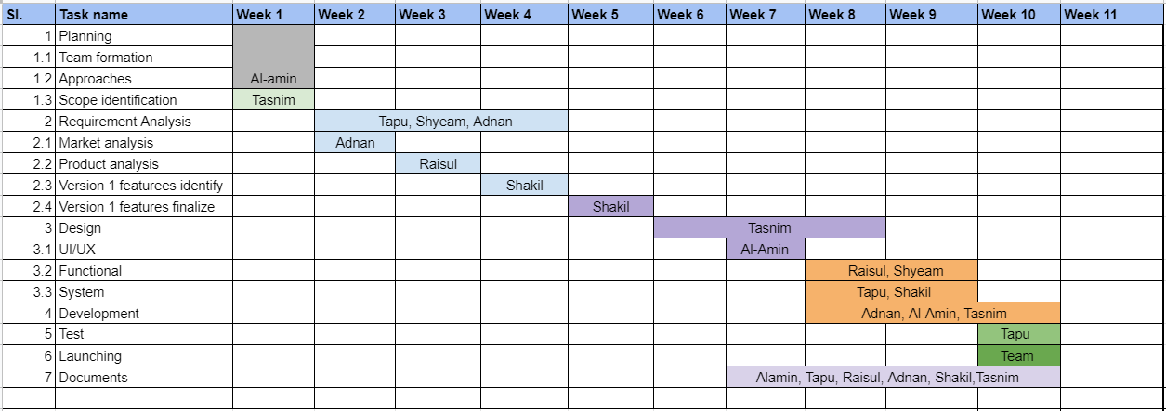
GANTT CHART

Slide 10
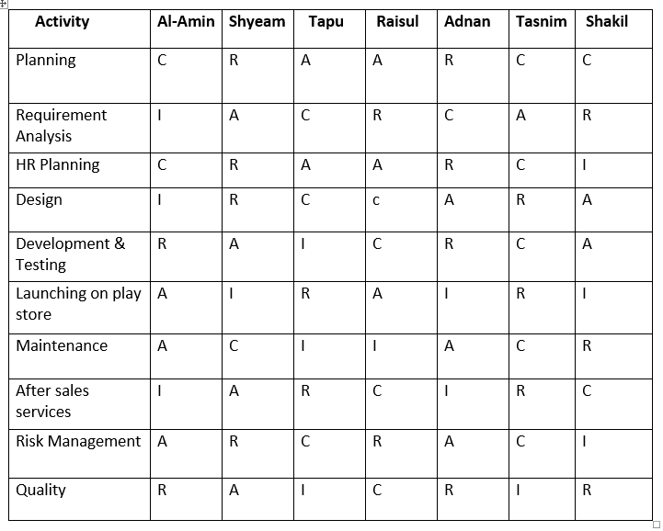
RACI MATRIX

Slide 11
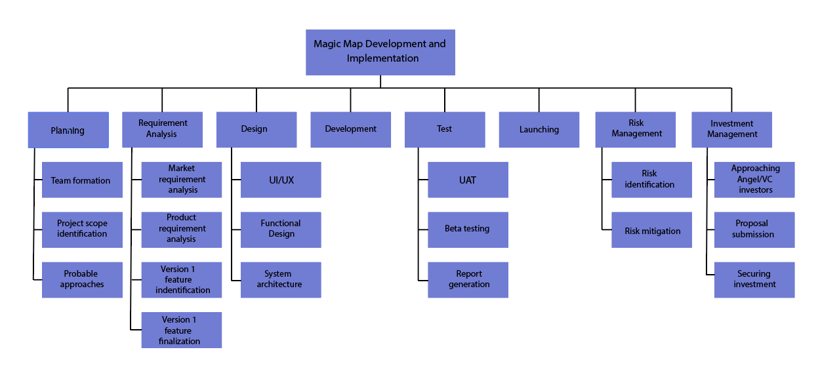
WBS ( WORK BREAKDOWN STRUCTURE )

Slide 12
MAIN BODY (SRS)

Slide 13
REQUIREMENT ANALYSIS
Here is the SRS ( Software requirement specification ) link
https://drive.google.com/file/d/16KsWPxHPgfJcq3UFji5MeJqiMNiQlJpp/view?usp=sharing

Slide 14
MAIN BODY (DSESIGN)

Slide 15
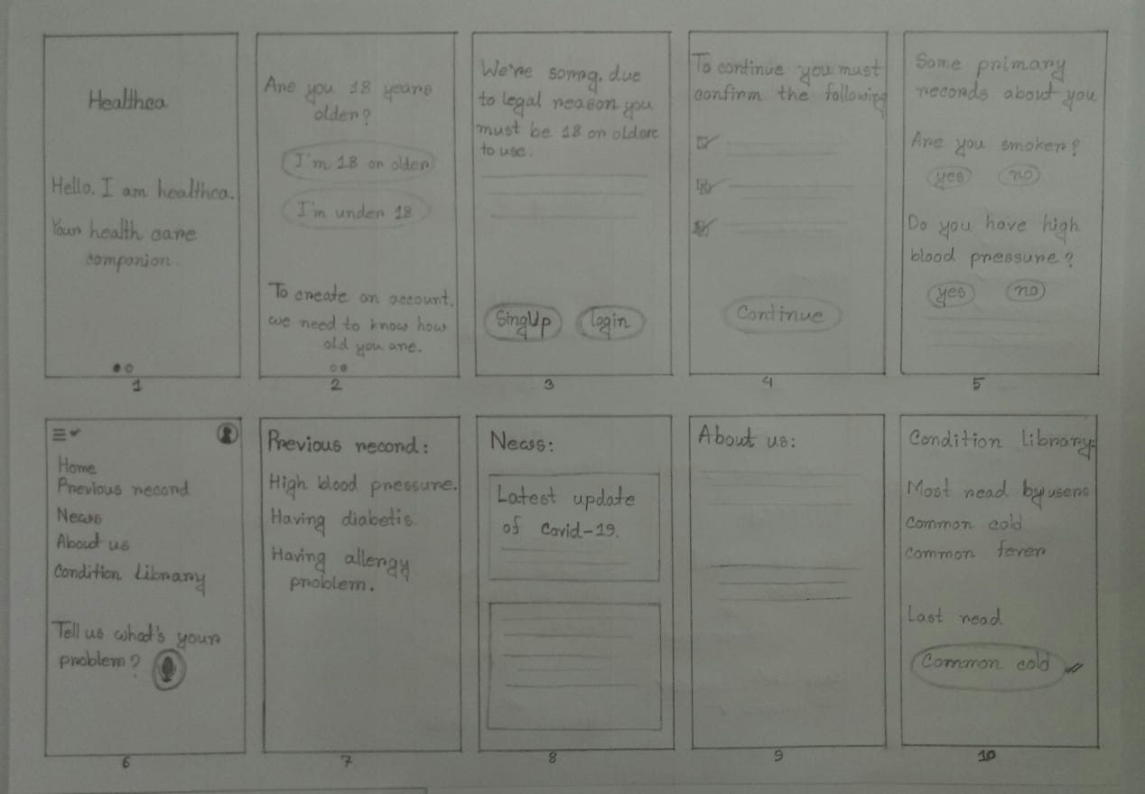
PAPER PROTOTYPE

Slide 16
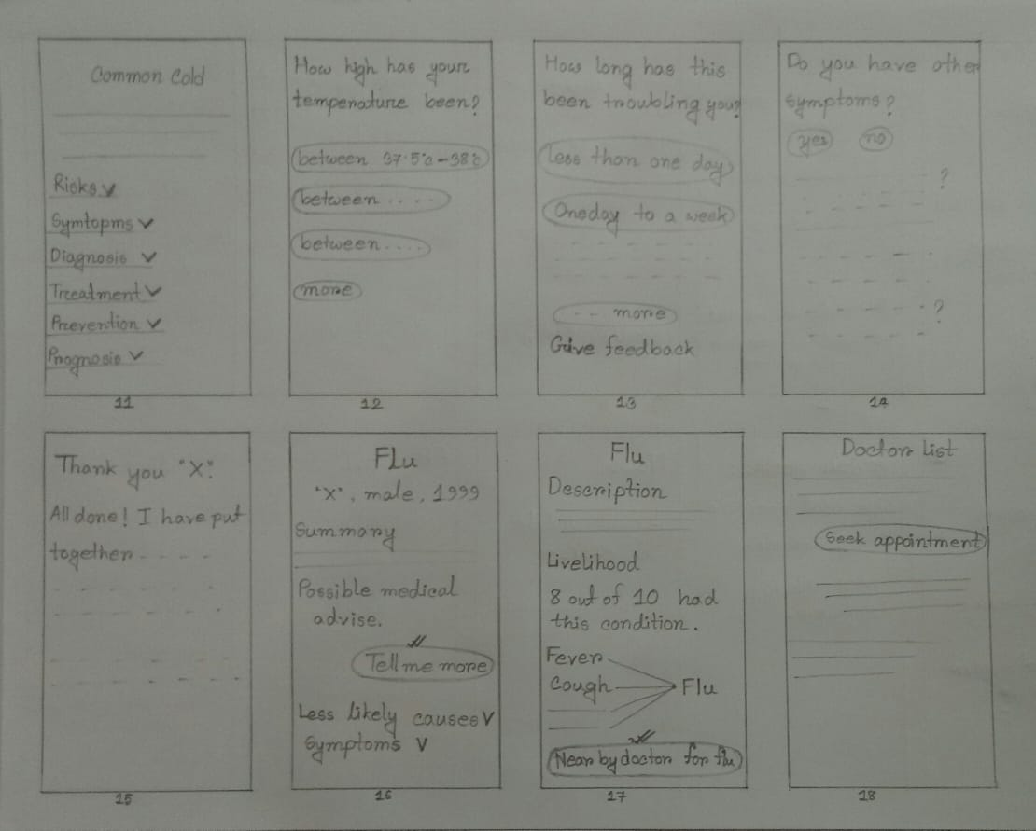
PAPER PROTOTYPE

Slide 17
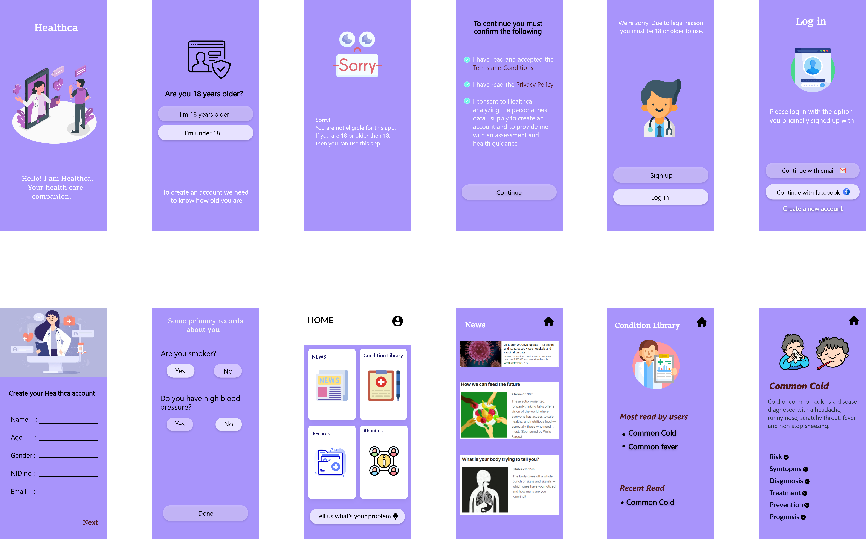
ADOBE XD

Slide 18
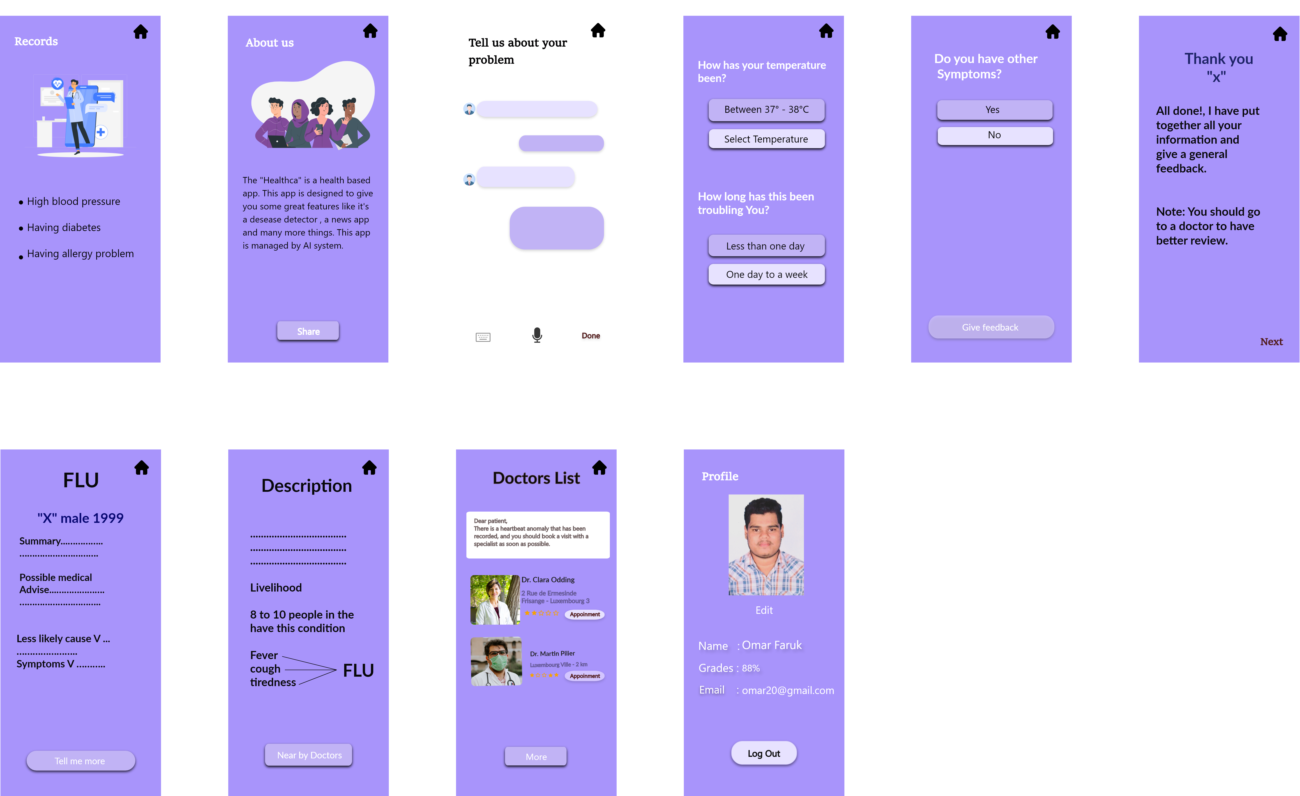
ADOBE XD

Slide 19


